Slide 1
Chapter 21 Concurrency Control Techniques

Slide 2
- Introduction - Two-Phase Locking Technique for Concurrency Control - Time stamping
Content

Slide 3
Introduction
Different protocols can be used to ensure serializability in schedules
DBMS uses some set of protocols to ensure concurrent execution of transactions
One important set of protocols two-phase locking protocols
employs the technique of locking data items to prevent multiple transactions from accessing the items concurrently.
Another set of concurrency control protocols uses timestamps.
A timestamp is a unique identifier for each transaction, generated by the system.
Timestamp are generated in order with the execution of transactions

Slide 4
Two-Phase Locking Techniques for Concurrency Control
Lock:
a variable associated with a data item that describes the status of the item with respect to possible operations that can be applied to it.
Generally, one data time has one lock in the database.
Used for synchronizing the access by concurrent transactions to the database items.
Now we will discuss:
Type of locks
How to ensure serializability with locking protocols
Problems with locks
Deadlock
starvation

Slide 5
Two-Phase Locking Techniques for Concurrency Control
Types of Locks and System Lock Tables
There are 3 types of locks:
Binary locks
Shared/exclusive locks
Certify lock

Slide 6
Two-Phase Locking Techniques for Concurrency Control
Types of Locks and System Lock Tables
Binary Locks:
Most simple type of locks
Not frequently used as they are too restrictive for database concurrency control.
A unique lock is associated with each database item X.
A binary lock can have two states or values:
locked (value= 1)
unlocked (value= 0)
Two operations can be performed on binary locks,
lock_item
unlock_item.

Slide 7
Two-Phase Locking Techniques for Concurrency Control
Types of Locks and System Lock Tables
Binary Locks:
If the value of the lock on X is 1,
item X cannot be accessed by a database operation that requests the item.
If the value of the lock on X is 0,
the item X can be accessed when requested, and the lock value is changed to 1.
A transaction requests access to an item X by first issuing a lock_item(X) operation.
If LOCK(X) = 1, the transaction is forced to wait.
If LOCK(X) = 0, it is set to 1 (the transaction locks the item) and the transaction is allowed to access item X.
When the transaction is done using the item, it issues an unlock_item(X) operation, which sets LOCK(X) back to 0 so that X may be accessed by other transactions.

Slide 8
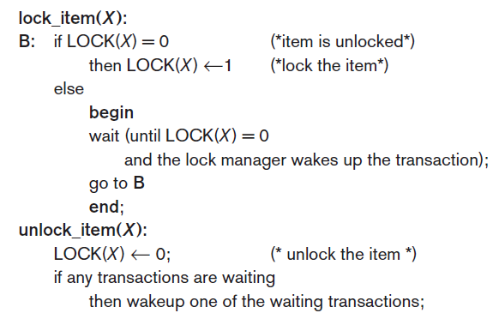
Two-Phase Locking Techniques for Concurrency Control
Types of Locks and System Lock Tables
Binary Locks:

Slide 9
Two-Phase Locking Techniques for Concurrency Control
Types of Locks and System Lock Tables
Binary Locks:
The wait command within the lock_item(X) operation is usually implemented by putting the transaction in a waiting queue for item X until X is unlocked, and the transaction can be granted access to it.
Other transactions that also want to access X are placed in the same queue.

Slide 10
Two-Phase Locking Techniques for Concurrency Control
Types of Locks and System Lock Tables
Binary Locks.
It is simple to implement a binary lock; all that is needed is a binary-valued variable, LOCK, associated with each data item X in the database.
The lock manager subsystem in DBMS keep track of and control access to locks.
Lock table contain the locks
Each lock can be a record with three fields: <Data_item_name, LOCK, Locking_transaction> And a queue for transactions that are waiting to access the item.
The system needs to maintain only these records for the items that are currently locked in a lock table.
Items not in the lock table are unlocked.

Slide 11
Two-Phase Locking Techniques for Concurrency Control
Types of Locks and System Lock Tables
Binary Locks.
For binary locking, every transaction must obey the following rules:
A transaction T must issue the operation lock_item(X) before any read_item(X) or write_item(X) operations are performed in T.
A transaction T must issue the operation unlock_item(X) after all read_item(X) and write_item(X) operations are completed in T.
A transaction T will not issue a lock_item(X) operation if it already holds the lock on item X.
A transaction T will not issue an unlock_item(X) operation unless it already holds the lock on item X.

Slide 12
Two-Phase Locking Techniques for Concurrency Control
Types of Locks and System Lock Tables
Binary Locks:
Between the lock_item(X) and unlock_item(X) operations in transaction T, T is said to hold the lock on item X.
At most one transaction can hold the lock on a particular item.
Thus, no two transactions can access the same item concurrently.

Slide 13
Two-Phase Locking Techniques for Concurrency Control
Types of Locks and System Lock Tables
Binary Locks:
Problem:
Binary locking scheme is too restrictive for database items because at most one transaction can hold a lock on a given item.
Neither read nor write operation is allowed by any two transactions at the same time

Slide 14
Two-Phase Locking Techniques for Concurrency Control
Types of Locks and System Lock Tables
Shared/Exclusive (or Read/Write) Locks:
Allow several transactions to access the same item X if they all access X for reading purposes only.
As two Read operations at same item are not conflicting
But for write operation, it must have exclusive access for the data item.

Slide 15
Two-Phase Locking Techniques for Concurrency Control
Types of Locks and System Lock Tables
Shared/Exclusive (or Read/Write) Locks:
A multiple-mode lock is used in this scheme.
There are three locking operations:
read_lock(X), write_lock(X), and unlock(X).
LOCK(X) has 3 possible states:
read-locked, write-locked, or unlocked.

Slide 16
Two-Phase Locking Techniques for Concurrency Control
Types of Locks and System Lock Tables
Shared/Exclusive (or Read/Write) Locks:
A read-locked item:
also called share-locked
because other transactions are allowed to read the item,
A write-locked item:
also called exclusive-locked
because a single transaction exclusively holds the lock on the item.

Slide 17
Two-Phase Locking Techniques for Concurrency Control
Types of Locks and System Lock Tables
Shared/Exclusive (or Read/Write) Locks:
One method for implementing the operations on a read/write lock is:
to keep track of the number of transactions that hold a shared (read) lock on an item in the lock table
along with the list of transaction ids that hold a shared lock.
Each record in the lock table will have four fields: <Data_item_name, LOCK, No_of_reads, Locking_transaction(s)>.

Slide 18
Two-Phase Locking Techniques for Concurrency Control
Types of Locks and System Lock Tables
Shared/Exclusive (or Read/Write) Locks:
The state of LOCK is either read-locked or write-locked.
LOCK(X) = write-locked,
the value of locking transaction(s) is a single transaction that holds the exclusive (write) lock on X.
LOCK(X) = read-locked,
the value of locking transaction(s) is a list of one or more transactions that hold the shared (read) lock on X.

Slide 19
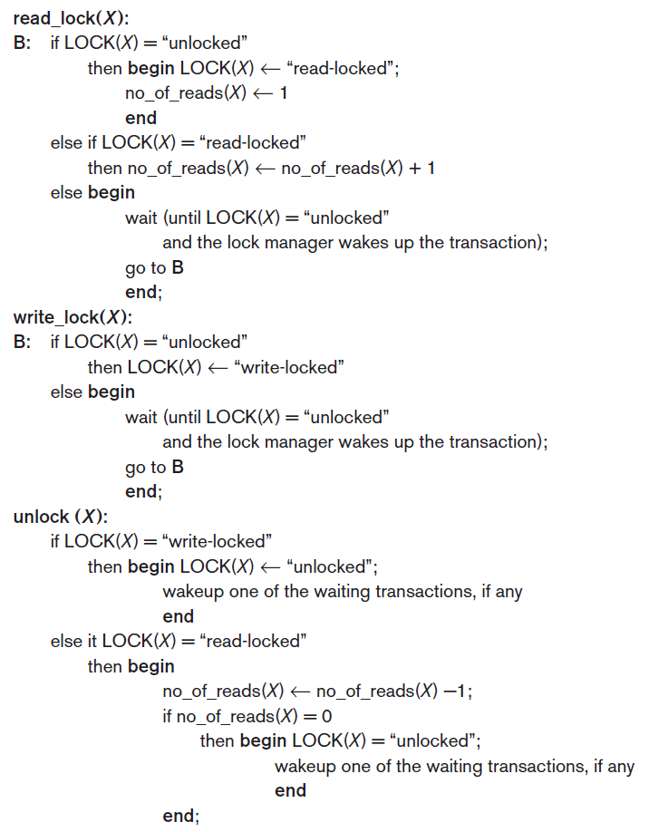
Two-Phase Locking Techniques for Concurrency Control
Types of Locks and System Lock Tables
Shared/Exclusive (or Read/Write) Locks.
Notes:
The first read on X
2nd condition is the 2nd or other read i.e. other item may be performing read
3rd condition is some one else is doing write on X so exclusive lock was placed on it wait till then

Slide 20
Two-Phase Locking Techniques for Concurrency Control
Types of Locks and System Lock Tables
Shared/Exclusive (or Read/Write) Locks.

Slide 21
Two-Phase Locking Techniques for Concurrency Control
Types of Locks and System Lock Tables
Shared/Exclusive (or Read/Write) Locks.
Notes:
Write lock just release locks
But read locks may have multiple items reading simultaneously so it’ll decrease reading count and if it’s the last reading item then release the lock

Slide 22
Two-Phase Locking Techniques for Concurrency Control
Types of Locks and System Lock Tables
Shared/Exclusive (or Read/Write) Locks.
When we use the shared/exclusive locking scheme, the system must enforce the following rules:
A transaction T must issue the operation read_lock(X) before any read_item(X) operation is performed in T.
i.e., Acquire lock first and then perform operation
A transaction T must issue the operation write_lock(X) before any write_item(X) operation is performed in T.
i.e., Acquire lock first and then perform operation
A transaction T must issue the operation unlock(X) after all read_item(X) or the write_item(X) operations are completed in T.

Slide 23
Two-Phase Locking Techniques for Concurrency Control
Types of Locks and System Lock Tables
Shared/Exclusive (or Read/Write) Locks.
When we use the shared/exclusive locking scheme, the system must enforce the following rules:
A transaction T will not issue a read_lock(X) operation if it already holds a read (shared) lock or a write (exclusive) lock on item X.
i.e, No two locks allowed at the same time on a data item
A transaction T will not issue a write_lock(X) operation if it already holds a read (shared) lock or write (exclusive) lock on item X.
A transaction T will not issue an unlock(X) operation unless it already holds a read (shared) lock or a write (exclusive) lock on item X.
i.e., T cannot unlock unless it has a acquired a lock

Slide 24
Two-Phase Locking Techniques for Concurrency Control
Types of Locks and System Lock Tables
Conversion (Upgrading, Downgrading) of Locks.
A transaction that already holds a lock on item X is allowed to convert the lock from one locked state to another.
Possible for a transaction T to issue a read_lock(X) and then later to upgrade the lock by issuing a write_lock(X).
If T is the only transaction holding a read lock on X at the time it issues the write_lock(X) operation, the lock can be upgraded;
otherwise, the transaction must wait.
Possible for a transaction T to issue a write_lock(X) and then later to downgrade the lock by issuing a read_lock(X).

